Slide 1

Getting started with CSS
Animations
Khurram Raheel

Slide 2



Why use CSS?
Coloring
Position
Sizing
Animations

Slide 3
CSS Animations
In CSS we can create animations allows animation of most HTML elements without using JavaScript, Flash or any other technology.

Slide 4
Transitions
Transition: transition: property duration timing-function delay;
The time
Animation will
take to start
List of CSS properties
Width, height,
font-size
Total time for
animation
Animation Running Style

Slide 5
Transformation
CSS Transformation allow us to rotate, scale, and skew elements.
Transformation does not affect the positioning of other elements.

Slide 6
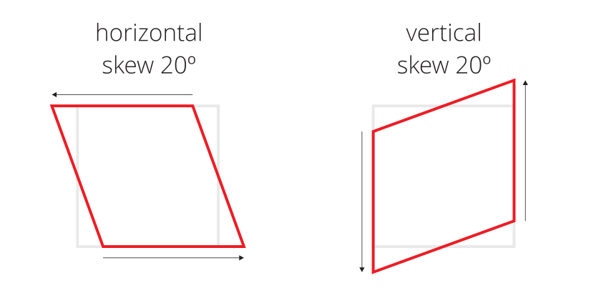
Transformation
Example> transform: scale(20px);
transform: skewY(20deg);

Slide 7
Transitions
div {
width: 100px;
height: 100px;
background: red;
-webkit-transition: width 2s, height 2s, -webkit-transform 2s; /* Safari */
transition: width 2s, height 2s, transform 2s;
}
div:hover {
width: 300px;
height: 300px;
-webkit-transform: rotate(180deg); /* Safari */
transform: rotate(180deg);
}

Slide 8
ANIMATIONS
CSS animations make it possible to animate transitions from one CSS style configuration to another. Animations consist of two components, a style describing the CSS animation and a set of keyframes that indicate the start and end states of the animation’s style, as well as possible intermediate waypoints.

Slide 9
Create a CSS animation(FROM –END)
Start @keyframes animationOne{
from {
//Initial CSS properties to be defined here
margin-left:20px;
}
to { //Final CSS properties to be defined here
margin-left:60px; }
}
div{
animation-name: animationOne;
animation-duration: 4s;
}

Slide 10
Create a CSS animation(multi-step animation)
@keyframes example {
0% {background-color: red;//Other properties here} 25% {background-color: yellow; //Other properties here} 50% {background-color: blue; //Other properties here} 100% {background-color: green; //Other properties here}
}

Slide 11
Today’s assignment
Create a 4 items menu which get bubbled when hovered.

